Slide 1
JAW SUSPENSION IN VERTEBRATES
BY
RAHEELA MUSHTAQ
(ASSISTANT PROFESSOR)
DEPT. OF ZOOLOGY,
GOVT. P. G. COLLEGE, RAJOURI

Slide 2
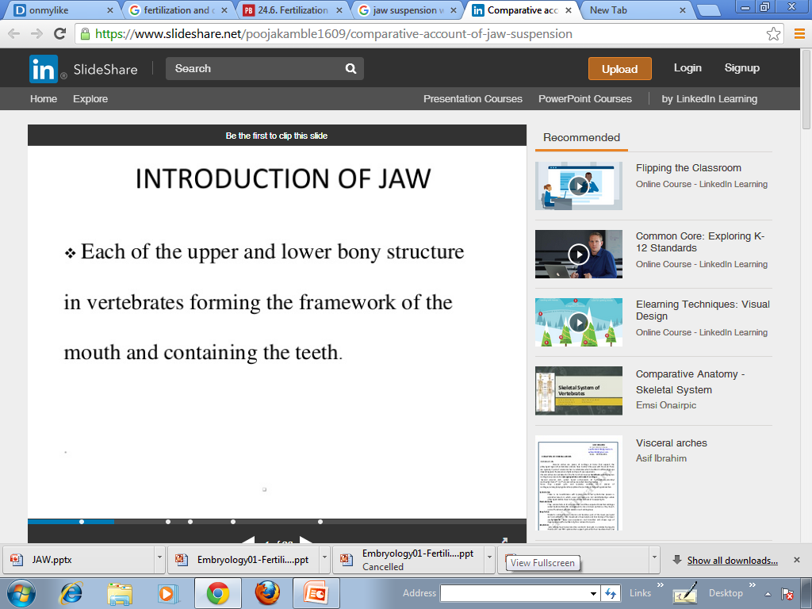

Slide 3
Jaw suspension means attachment of the lower jaw with the upper jaw or the skull for efficient biting and chewing.
There are different ways in which these attachments are attained depending upon the modifications in visceral arches in vertebrates.

Slide 4
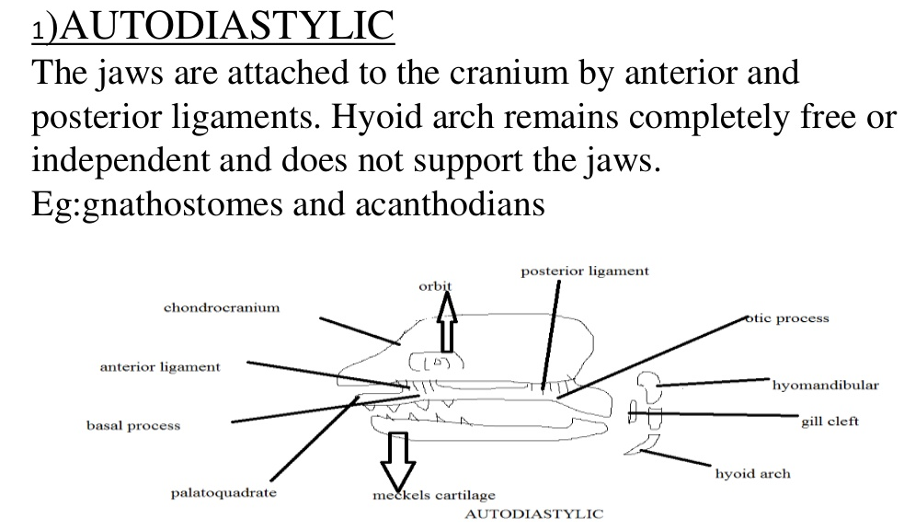

Slide 5
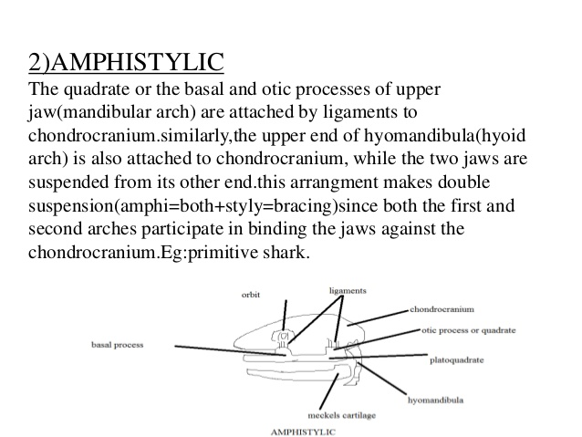

Slide 6
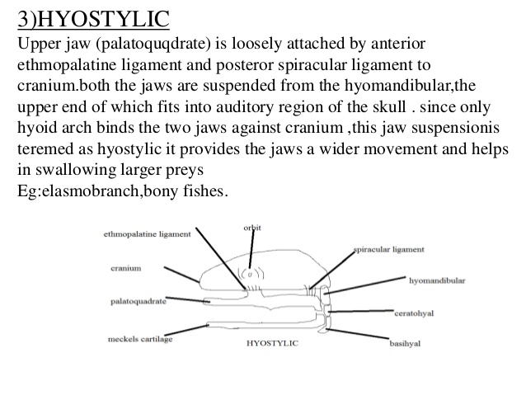

Slide 7
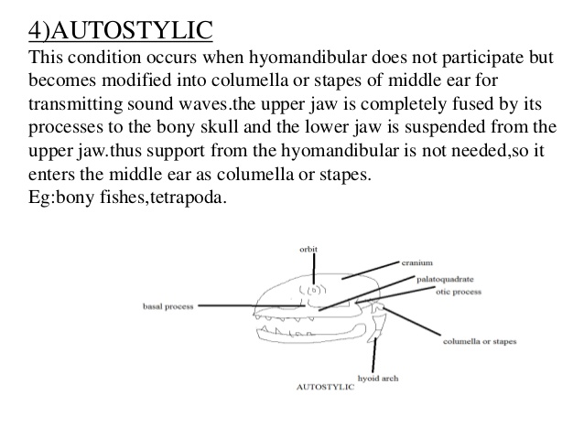

Slide 8
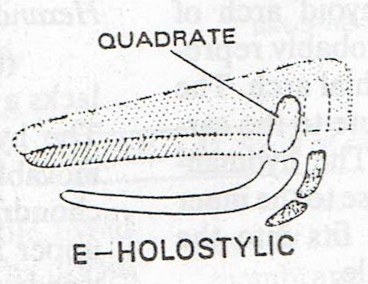
Autostylic jaw suspension is of different types
i} Holostylic – The hyoid arch is complete and free from chondrocranium. The lower jaw hangs from the quadrate region of the upper jaw. This condition developed in the ancient placoderms and is still seen in Holocephali i.e.,Chimaera

Slide 9
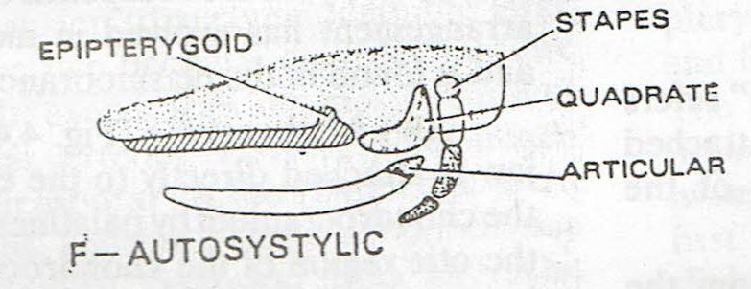
ii} Autosystylic – The hyoid arch is broken up, its hyomandibular cartilage is reduced and transformed into an ear ossicle – the columella or stapes – on either side. The lower jaw articulates by its articular part with the quadrate region of upper jaw.eg lung fishes and tetrpods except mammals.If quadrate is movable then jaw suspension is said to be streptostylic eg-lizards, snakes and birds. If quadrate is firmly fixed then the jaw suspension is said to be monimostylic. Eg- other tetrapods.

Slide 10
